Slide 1

The Pursuit of Happiness
An analysis of the World Happiness Report
Scattegories

Slide 2
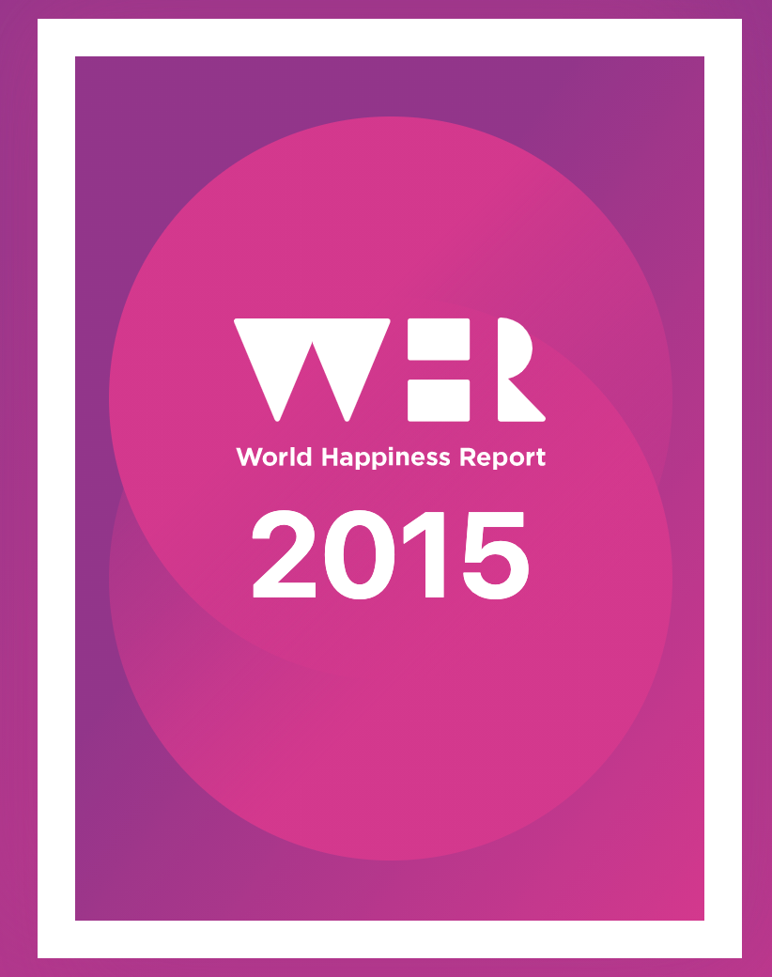
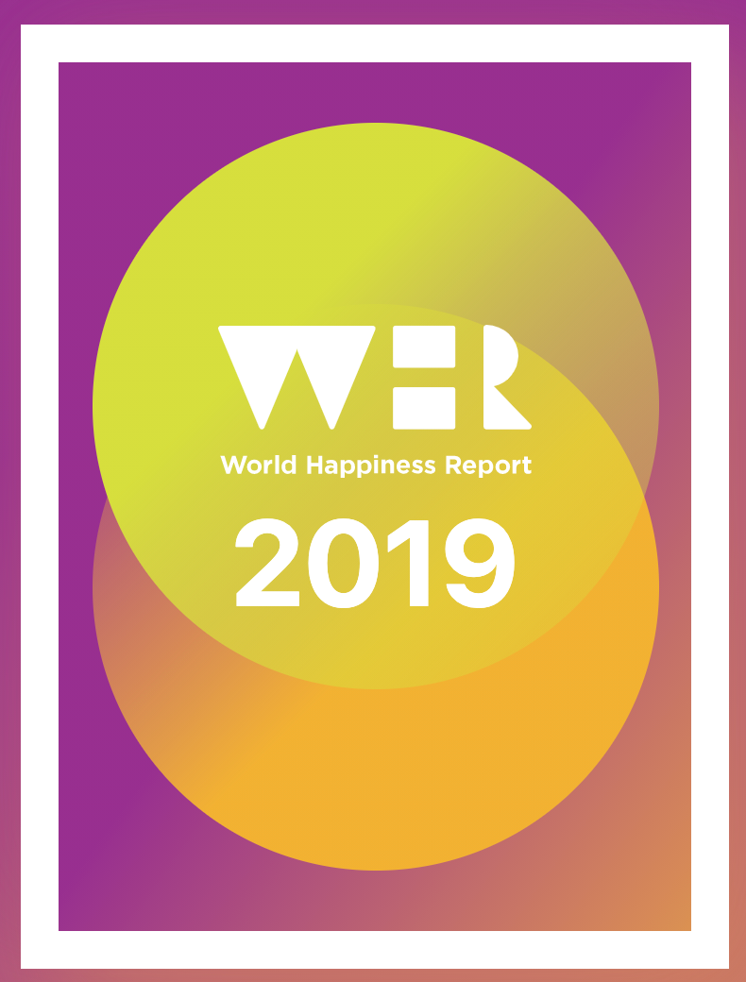
Background on Dataset
Publication of UN Sustainable Development Solutions Network based on Gallup polling
Goals: Use happiness indicators to inform policy making decisions
Used data looking at 170 countries spanning five year period from (2015 - 2019)

Slide 3
Data Cleaning:
The Cleaning Process

Slide 4
Data Collection
What’s in a name?
Year over Year
Region
Country
Column naming
NaN values
Country Naming
Duplicates
Political Renaming
Punctuation

Slide 5
What did we need?
DataFrame Creation
Come up with Questions
Group questions by columns or data they had in common ie. Happiness Score or Life Expectancy
Pull in columns we needed
Tweak it until it makes sense

Slide 6
Our Questions & Findings

Slide 7
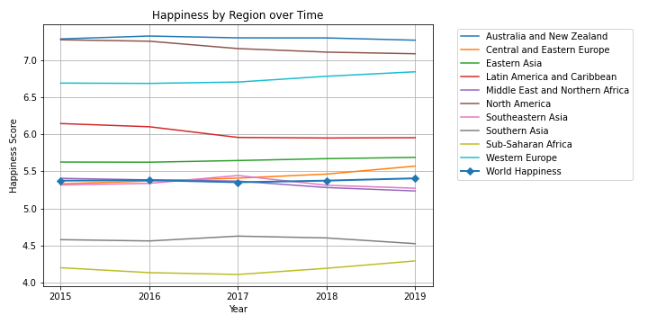
Changes in Happiness over Time (2015-2019)
Was there regional instability in happiness levels between 2015-2019? How did happiness change on a global level from 2015-2019? Did the happiest countries get happier? Did the least happy countries get less happy?
Notes:
First we started by looking at how happiness changed over time, with data from 2015-2019. We had data on approximately 155 countries, divided into 10 different regions. We wanted to know if there was regional instability in happiness over time, what happiness did on a global level, and whether or not the happiest countries got happier and the least happy countries got less happy. Looking at our graph of mostly straight lines here, which are tracking regional happiness over time, you can say that there wasn’t a lot of movement in terms of regional happiness, particularly in relation to one another. The Global happiness level, the line with the circles near the middle, is almost entirely flat.

Slide 8
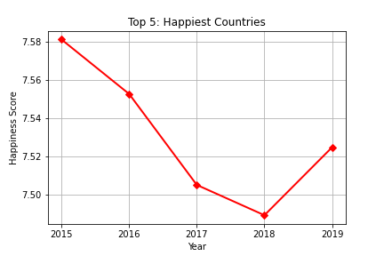
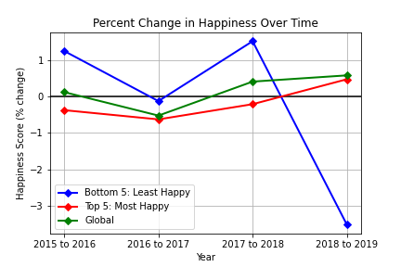
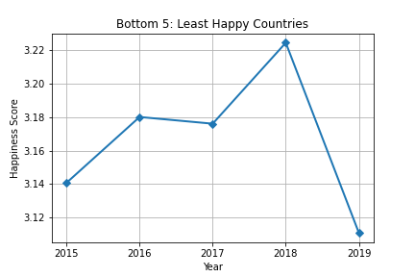
Changes in Happiness over Time (2015-2019)
Was there regional instability in happiness levels between 2015-2019? How did happiness change on a global level from 2015-2019? Did the happiest countries get happier? Did the least happy countries get less happy?
Notes:
But we want to look a little closer. If there wasn’t a lot of change in regards to how happiness changed regionally in relation to each other, what about when we looking exclusively at the happiest and least happy countries? Our two graphs on the left are the most happy and least happy countries. You can see that there are changes year-to-year in happiness that was harderer to see at a macros level. I also found in interesting that in the 5 year period, the happiness of the most and least happy are inversely correlated -- when happy countries got happier, less happy countries got less happy, and vice versa. The final graph here shows the percentage change in happiness year to year for the most and least happy, and at a global level. The most happy countries changes year to year largely reflected the global changes. Happiness in the least happy countries was more turbulent, with a 3% drop from 2018 to 2019.

Slide 9
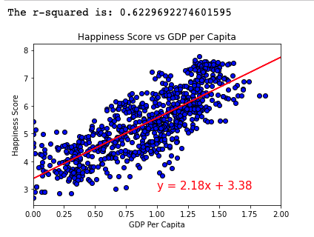
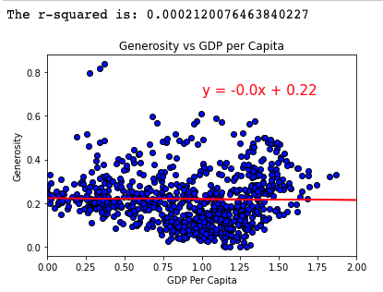
Does the economy have an effect on citizens’ happiness? Does a better economy lead to more generous citizens?
Notes:
First we wanted to know if the economy had an effect on happiness. We looked at our GDP per capita and happiness score data in order to see if there was a relationship between the two. GDP or Gross domestic product is a good indicator of economic performance of a country. As you can see when looking at the first chart their is a moderate positive relationship between GDP and happiness score. On average as GDP of a country increased so did their happiness score. This result was not shocking to us, as we hypothesized this in the beginning.
So after confirming that as GDP increased so did happiness we wanted to know if as GDP increased did generosity also increase? In other words we wanted to know if people had more money did that also make them more generous? The results were pretty interesting to see. As you can see in the scatter plot on the right there was no relationship between GDP and generosity.

Slide 10
Life, Liberty & Happiness:
Plot 1 : Freedom vs. Happiness Score
Questions:
Do countries that are freer have happier citizens. If so, what is the correlation?
Our Assumption: Yes
Plot 2: Freedom vs. Health (Life Expectancy)
Questions:
Do countries that are freer consistently have citizens that live longer?
Our Assumption: Yes

Slide 11
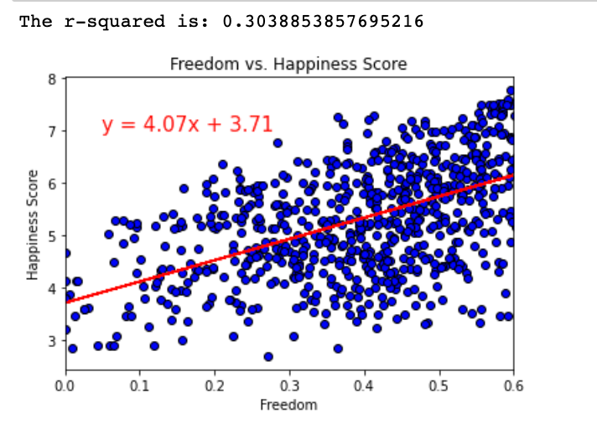
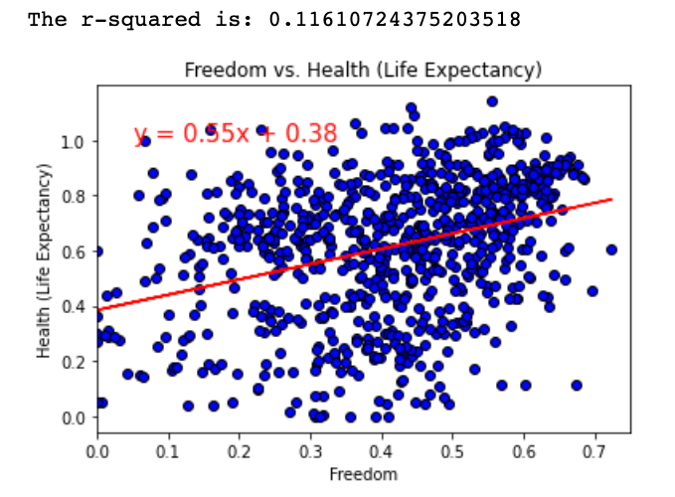
Results: Which has a greater impact on freedom?
There is a weak positive correlation for both but it is stronger when comparing Freedom vs. Happiness score

Slide 12
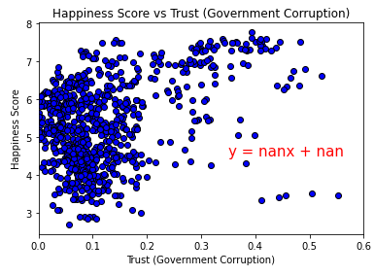
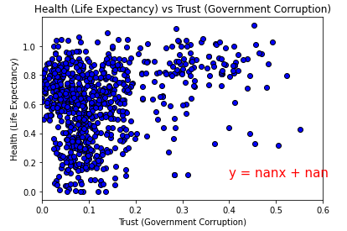
Trust (Government Corruption) on Happiness
Regression Analyses run using the Trust (Government Corruption) variable returned NaN
No apparent relationship between the Happiness and Trust; Health and Trust
Other analyses run also showed no relationship (ie: GDP and Trust)
Potential cultural issue?
Notes:
We also wanted to know how Trust, the variable measuring perceived Government Corruption, affects happiness. As we started to run our analyses, we noticed that there was a strange trend - all the R-Squared values came back as NaN. As a result, Trust seems to have zero relationship with the other variables, at least within the limitations of the Linear Regression Model.
While we may never know the true reason behind this, we speculate that there may be a cultural component to the Trust variable that is not observed as strongly in the others. This could be anything ranging from Government Corruption not being on the forefront of people’s minds in most countries, all the way to fear of punishment from one’s government if an unfavorable rating was provided.

Slide 13
If we had more time...
We would have created a happiness heatmap
If there was more data available across more time and how that would influence our models
Dive deeper into country to country models
We would love to add in 2020 data once it comes out next month

Slide 14
Questions?

